Slide 1

Workshop on: Deep Learning and image segmentation Applications in Medical Domain

Slide 2

Introduction Noor Hussain is a CEH, CHFI and President at Student’s Developer Society BUETK. He is currently conducting his final year project research on Automatic brain tumor detection and segmentation based on Improved UNET by using Convolutional neural networks.
Guest Speaker: Noor Hussain

Slide 3
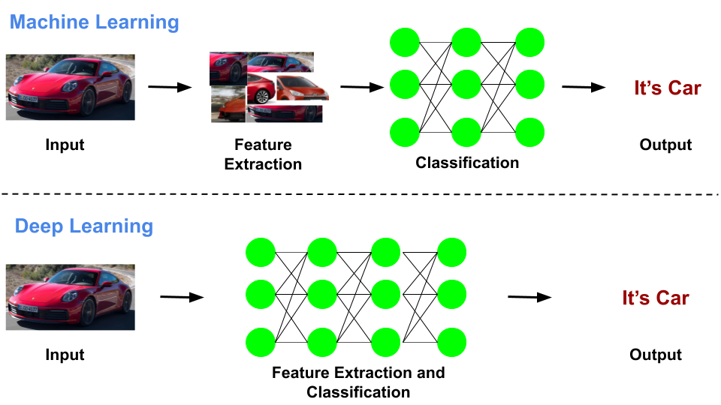
Deep learning
Deep learning uses artificial neural networks designed to imitate the way humans think and learn.
Deep Learning: to be the next frontier of machine learning.
Deep learning is also known as neural organized learning and happens when artificial neural networks learn from large volumes of data. Deep learning algorithms perform tasks repeatedly, tweaking them each time to improve the outcome. The algorithms depend on vast amounts of data to drive "learning.“ -Coursera.org
Image credit: www.google.com

Slide 4
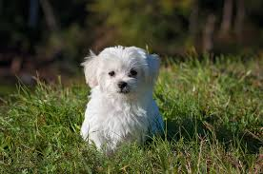
Image Segmentation
Let’s understand image segmentation using a simple example. Consider the below image:
Only one object here i.e a dog. We can build a straightforward cat-dog classifier model and predict that there’s a dog in the given image.

Slide 5
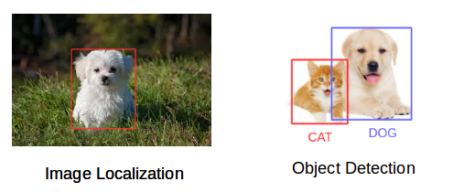
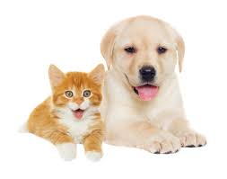
But what if we have both a cat and a dog in a single image? Example shown in Image 1 below.
We can train a multi-label classifier, in that instance. Now, there’s another issue – we won’t know the location of either animal/object in the image.
But We can predict the location along with the class for each object using Object detection.
We can predict the location along with the class for each object using Object detection. Example Shown in Image 2 below
Before detecting the objects and even before classifying the image, we need to understand what the image consists of
Image 1
Image 2
Image credit: www.google.com

Slide 6
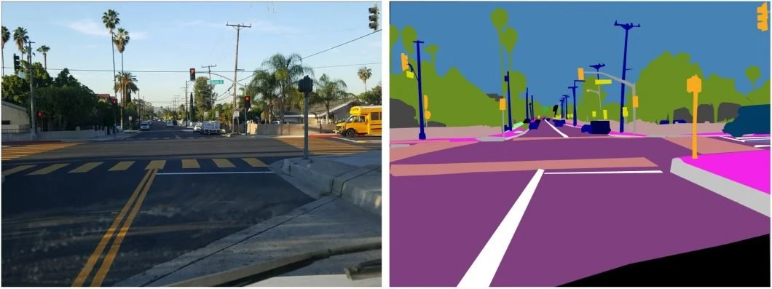
How Image Segmentation Works?
We can divide or partition the image into various parts called segments. It’s not a great idea to process the entire image at the same time as there will be regions in the image which do not contain any information.
By dividing the image into segments, we can make use of the important segments for processing the image.
Image credit: www.google.com

Slide 7
Why do we need Image Segmentation?
Utilization of Image Segmentation in Medical Domain
Cancer has long been a deadly illness. Even in today’s age of technological advancements, cancer can be fatal if we don’t identify it at an early stage. Detecting cancerous cell(s) as quickly as possible can potentially save millions of lives.
The shape of the cancerous cells plays a vital role in determining the severity of the cancer. object detection will not be very useful here. We will only generate bounding boxes which will not help us in identifying the shape of the cells. E.g Image 3 & 4

Slide 8
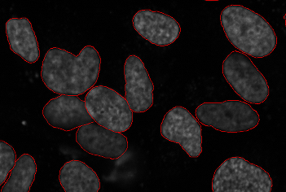
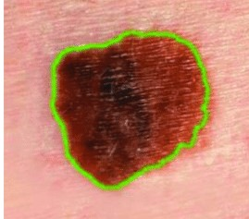
Skin cancer
Image 3 and 4
Image credit: https://www.researchgate.net/figure/Segmentation-of-skin-lesion-a-original-RGB-image-b-binary-mask-c-traced-skin_fig1_312251492

Slide 9
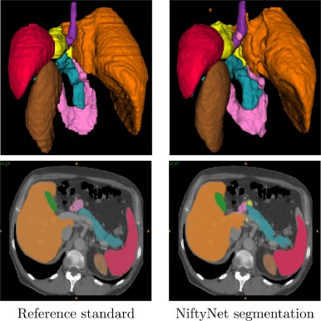
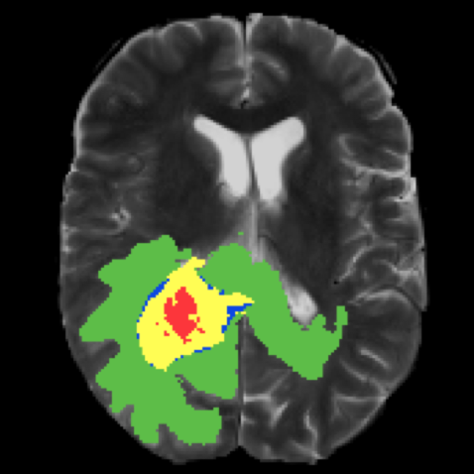
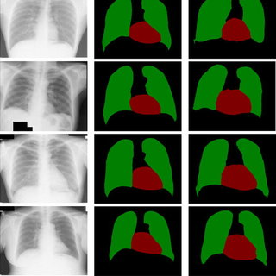
Brain tumor segmentation
Lungs segmentation
Image credit: https://paperswithcode.com/task/brain-tumor-segmentation
& www.Researchgate.com

Slide 10
Thank You
If You have any questions ?
You can ask me

